Slide 1
Information Security Risk & Compliance (ISRC)
Bishop Fox and Penetration Testing at Bayview
Henry Post - May 2026

Slide 2

Meta slide
Who are you?
  Nice to meet you! I’m Henry Post. I lead AppSec and I’ve been at Bayview for 3 years, US Bank for 4 years previously. I love baking, cooking, fighting games, gardening, weightlifting, and am currently studying for the OSCP exam (hacking exam). I specialize in Application Security and penetration testing. My personal site is https://drakonix.systems/ if you’re curious about other projects I’ve worked on. I host some infra there for animal shelters.
How did you generate your diagrams?
  I use Mermaid to generate diagrams. If I could, I would use LaTeX or pure Markdown plus pandoc CLI for deterministic formatting for this entire PPTX.
    https://github.com/Mermaid-Chart/vscode-mermaid-chart
Are there guides related to AppSec?
  Yes! There are many below.
    https://bayview0.sharepoint.com/sites/ApplicationSecurity

Slide 3
What is Bishop Fox? 1
Bishop Fox is a penetration testing vendor.
  We hire them to try to hack into web applications that we host.
  Here are their offerings:
    EPT: Time-bound, external penetration tests. Quarterly
    CASM: Cosmos Attack Surface Management: automated external scanning
    CAPT: Time bound, external deep dive penetration tests. Very hands-on
Larger Bishop Fox FAQ:
https://bayview0.sharepoint.com/sites/ApplicationSecurity/SitePages/FAQ--Bishop-Fox-Penetration-Testing.aspx

Slide 4
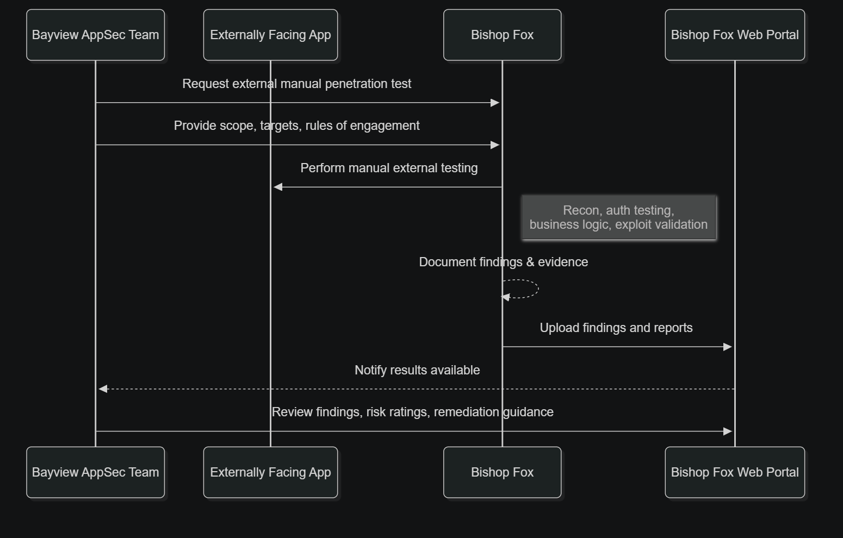
What is Bishop Fox? 2
TL;DR: They attack our external apps and give us feedback. We fix and they validate.

Slide 5
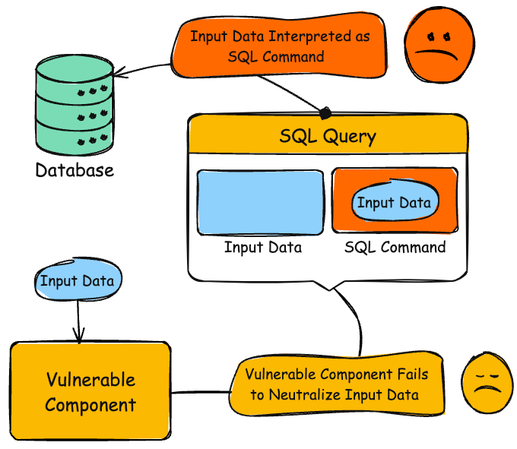
What do pentest vendors find in general?
A good starting point is the OWASP Top Ten.
  https://owasp.org/Top10/2025/
  My favorite is “Injection”, because of its high impact. An example of this is SQL injection. https://cwe.mitre.org/data/definitions/89.html
The OWASP Top Ten is an industry standard that lists the top ten most commonly exploited categories of web application vulnerabilities.
In addition to this:
  Business logic errors (i.e. ‘this user can access any loan’)
  Missing authentication (i.e. ‘this user can spoof a role’)
  API security findings (i.e. BOLA: Broken Object Level Authorization; ‘you can access /users/2 by fiddling the URL parameter even though you shouldn’t be able to’)
  Sensitive information disclosure (debug logs)
  Cryptographic failures (weak encryption, guessable randomization)
  Many, many more. MITRE CWE and OWASP are great resources.

Slide 6
What have they found?
A lot! Bishop Fox has found many different vulnerabilities through a combination of their testing types:
  Missing authentication on web apps
  SQL Injection (essentially database remote code execution)
  Config errors that only exist in non-prod
  Forgeable user roles due to a lack of server-side validation
  Cross-Site Scripting (javascript injection on the browser)
    This can be used to steal session tokens or phish users, among many other useful things from an attacker POV.
  …many more.
It’s important to continually test websites because there’s a lot of vulnerabilities that static scanning tools (SAST), and even DAST (Dynamic Web-based testing) tools don’t detect!
  Business logic errors
  Auth that doesn’t actually work or enforce a role
  Situational vulnerabilities that only surface after you deploy code to a real host
    …or that only surface when a real user is using your web application.
  Code changes that cause dormant vulnerabilities to surface

Slide 7
Switching Vendors?
We are switching penetration test vendors this year and have a few in mind.
  Final Frontier and NetSPI are our current picks. More are in an internal list in SharePoint.
It’s beneficial to switch penetration vendors for a few reasons.
  New perspectives: Each vendor has its own collection of experts
  New tools: Each vendor has a different tool list and training methodology
  New pricing: It’s possible we will save money by switching
  Industry pressure: At a macro level, it encourages vendors to compete with eachother.

Slide 8
Penetration Testing: FAQ and Questions
What sites have you already tested?
  I have an internal list I can provide, but so far: LoanDock Client Site, LoanView, FastLane Web, CLS.com, LMS Italia Frontend/Backend, and Silver Hill Document Portal.
What sites are you planning to test?
  HomeLend, LakeviewConnect, LMS Italia Frontend/Backend (again), LoanDock Client Site (again).
How long do pentests take?
  Generally, 1-2 weeks depending on how big the app is.
  We get the same amount of time for re-test: Re-test is when we fix the vulnerability, and the vendor validates that the fix actually fixed the vulnerability. So, an engagement usually takes a month per-app.
What is in scope?
  All externally-accessible sites that Bayview deploys, usually only if we have source code. There is 1 site, HomeLend, that we self-host in AWS, but lack source code for, but we are testing it because it has a very high business importance.
<Please feel free to ask a question>

